Slide 1
ENCA not Cleaning Agent —— a cleaning agent picker
Agenda
Introduction (Haoze Zhang)
Business Logic Structure (Zhaowen Gong)
Data Access and Testing (Zeling Wu)
Android application (Xiaoqi Ma)
Demo
20-07-2016

Slide 2
Team
Haoze Zhang Requirement analysis, system structure, UI design and team collaboration.
Zhaowen Gong Business logic implementation, UI implementation and code revision.
Zeling Wu Data acquisition, database management and testing.
Xiaoqi Ma Android application, UI design and implementation.
Collaboration platform: GitHub: https://github.com/Nimita311/ENCA-Andriod

Slide 3
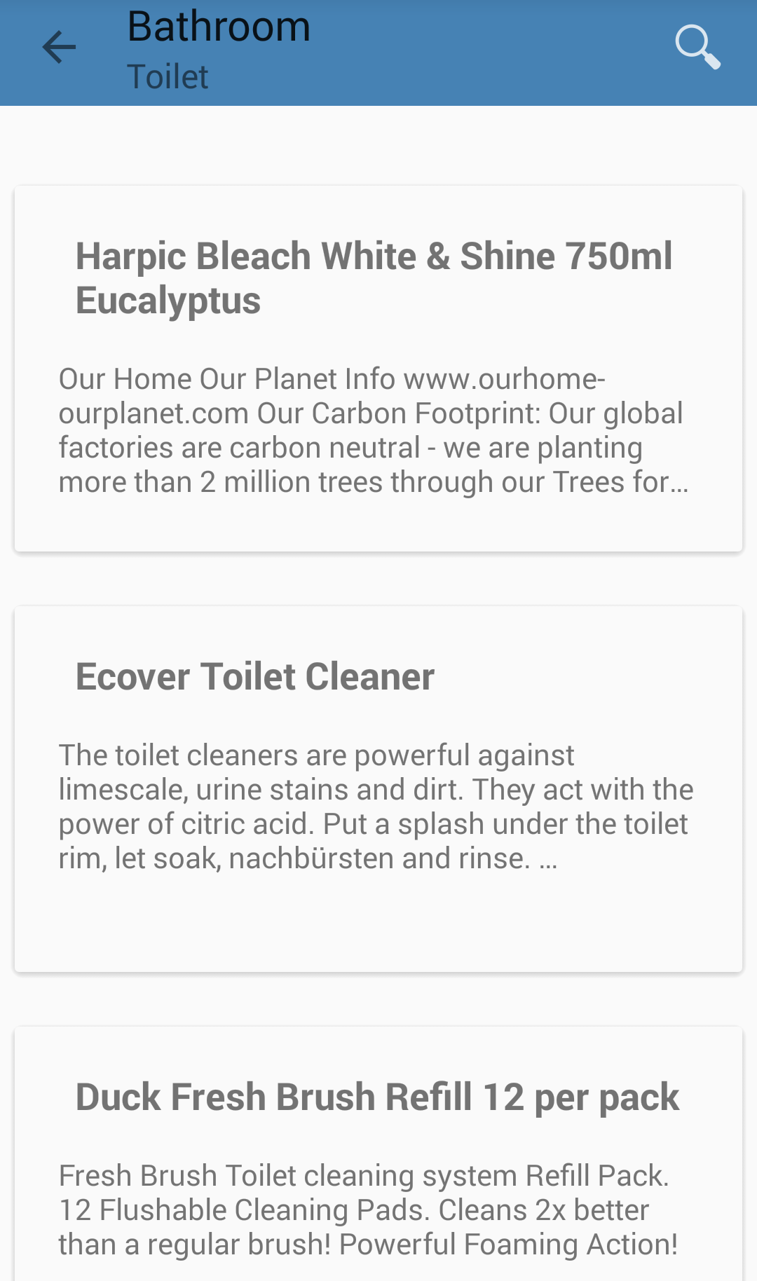
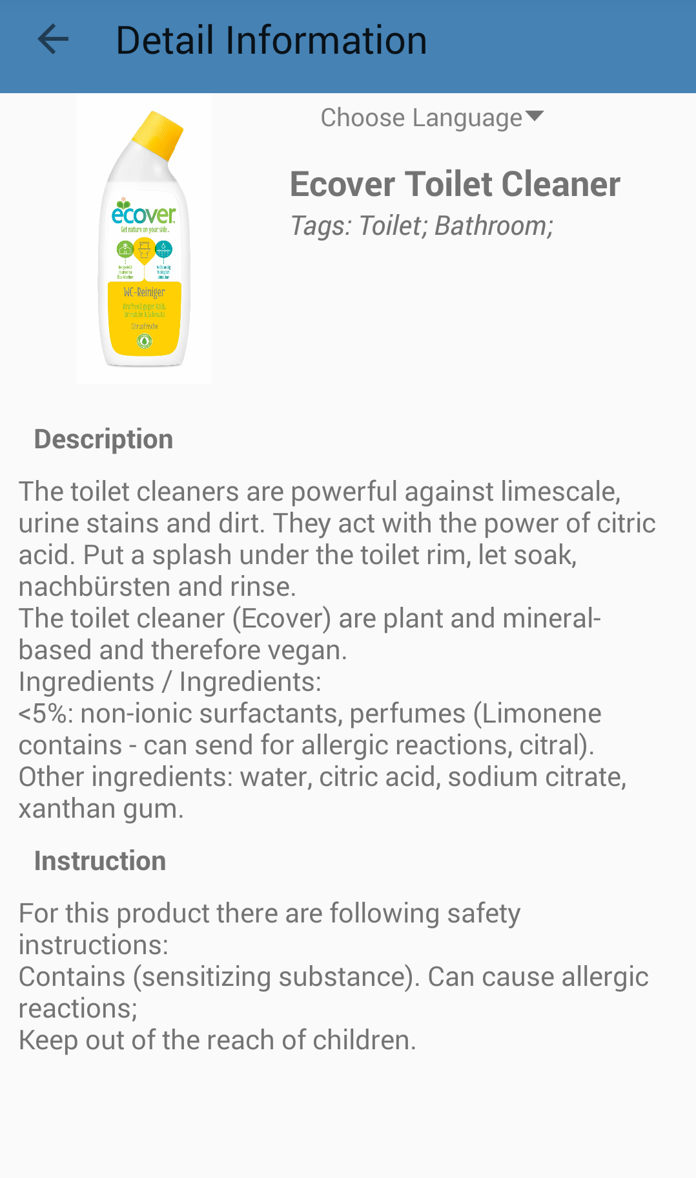
Additional Task
Android: ENCA express

Slide 4
Scenarios of Use
Scenario 1: (with ENCA) Cleaning purpose -> Cleaning agent
Scenario 2: (with ENCA) Cleaning agent's name or description -> Cleaning agent
Scenario 3: (with ENCA-express) Want to buy a cleaning agent -> show the seller

Slide 5
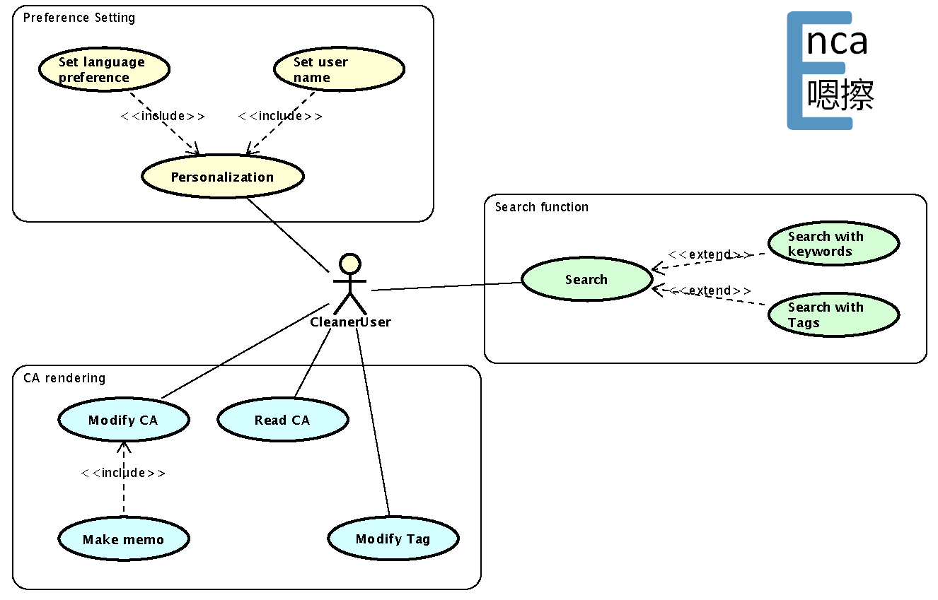
Use Cases

Slide 6
Business Logic Structure MVC

Slide 7
Business Logic Structure Multi-Language Support

Slide 8
Business Logic Structure Preferences

Slide 9
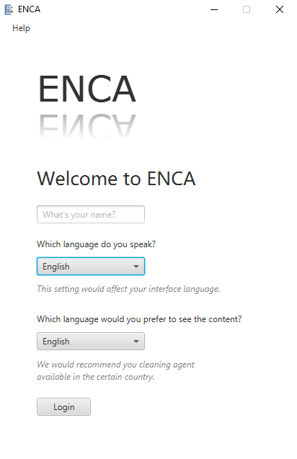
GUI Design
JavaFX structure
Main class
FXML file expressing interface
Separate controller
css file controlling style
More flexible layout
Better look
Flat design
Primary color: Steel Blue, RGB(70, 130, 180)
Secondary colors:
Consistency
Room
Items
Others

Slide 10
Data Access Logic

Slide 11
Entity Relation

Slide 12
Test
Unit Test InternationalStringTest
Module Test SQLAmenderTest, SQLVisitorTest
Integration Test TagOperatorTest

Slide 13
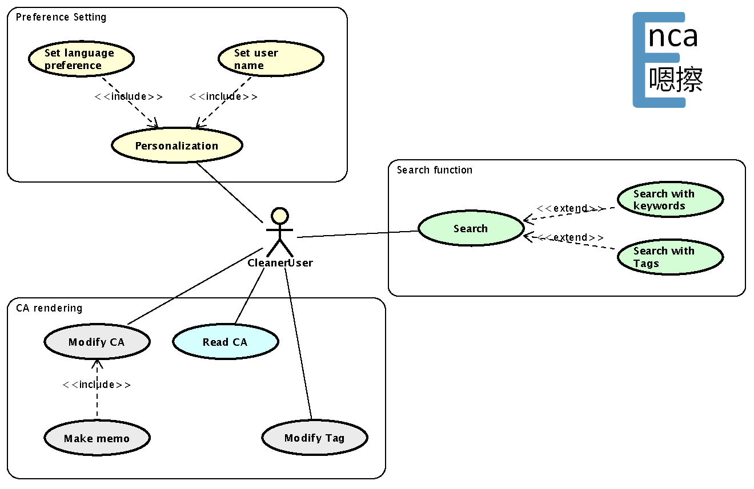
Android Use case

Slide 14
Demo
ENCA-express
ENCA

Slide 15
ENCA not Cleaning Agent —— a cleaning agent picker
Thank you
For more information:
https://github.com/Nimita311/ENCA-Andriod
20-07-2016

